Slide 4
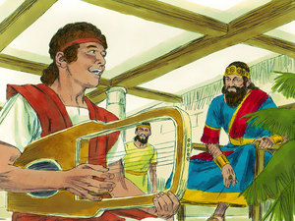

Slide 5
And Saul took him that day and would not let him return to his father's house.
1 Samuel 18:2

Slide 6
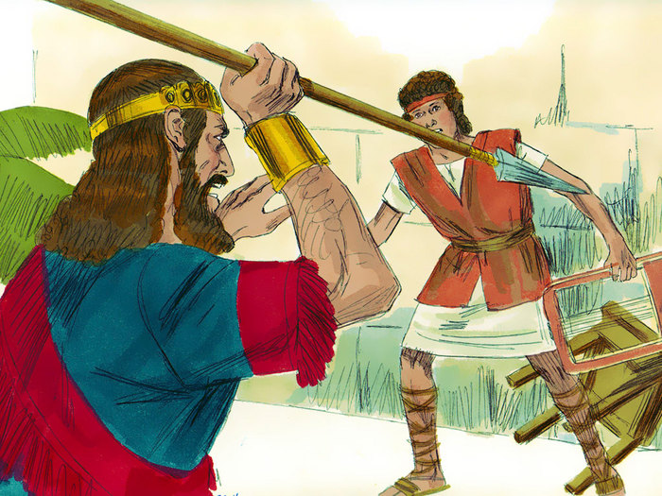

Slide 7
he raved within his house while David was playing the lyre, as he did day by day. Saul had his spear in his hand. 11 And Saul hurled the spear, for he thought, “I will pin David to the wall.” But David evaded him twice.
1 Samuel 18:10-11

Slide 8
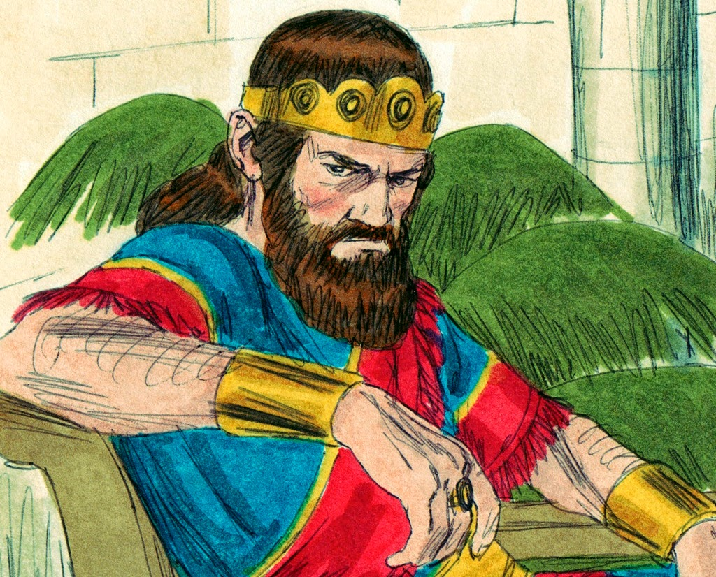

Slide 9
5 And David went out and was successful wherever Saul sent him, so that Saul set him over the men of war. And this was good in the sight of all the people and also in the sight of Saul's servants.
1 Samuel 18:5

Slide 10
12 Saul was afraid of David because the Lord was with him but had departed from Saul.
1 Samuel 18:12

Slide 11
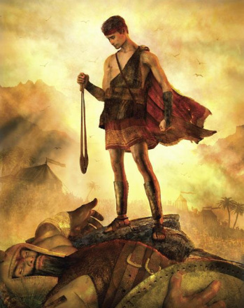

Slide 12
HE GIVES HIM A FRIEND

Slide 13
As soon as he had finished speaking to Saul, the soul of Jonathan was knit to the soul of David, and Jonathan loved him as his own soul.
1 Samuel 18:1

Slide 14
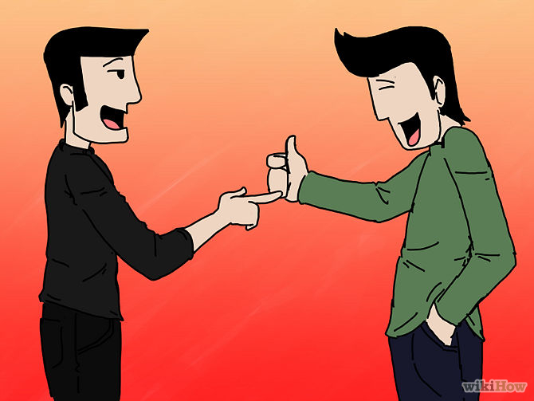

Slide 15
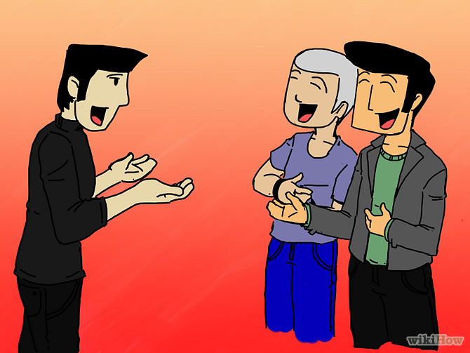

Slide 16
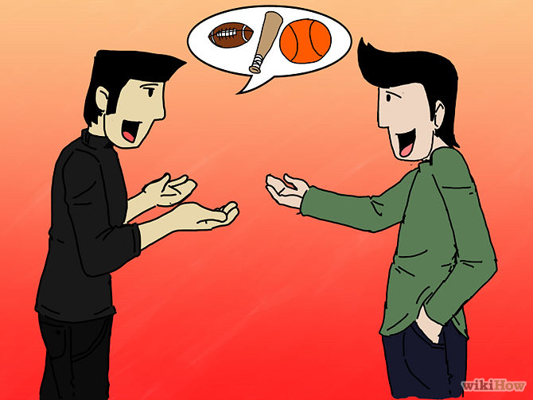

Slide 17
INTIMATE
FRIENDS

Slide 18
SACRIFICE
³ Then Jonathan made a covenant with David, because he loved him as his own soul. ⁴ And Jonathan stripped himself of the robe that was

Slide 19
SACRIFICE
on him and gave it to David, and his armor, and even his sword and his bow and his belt.
1 Samuel 18:3-4

Slide 20
LOYAL
“Let not the king sin against his servant David, because he has not sinned against you, and because his deeds have brought good to you. 5 For he took his life in his hand and he struck down the Philistine,

Slide 21
LOYAL
and the Lord worked a great salvation for all Israel. You saw it, and rejoiced. Why then will you sin against innocent blood by killing David without cause?”
1 Samuel 19:4-5

Slide 22
FREEDOM
⁴¹ And as soon as the boy had gone, David rose from beside the stone heap^{[f]} and fell on his face to the ground and bowed three times.

Slide 23
FREEDOM
And they kissed one another and wept with one another, David weeping the most.
1 Samuel 20:41

Slide 24
ENCOURAGE
¹⁵ While David was at Horesh in the Desert of Ziph, he learned that^{[a]}Saul had come out to take his life.

Slide 25
ENCOURAGE
¹⁶ And Saul’s son Jonathan went to David at Horesh and helped him find strength in God.
1 Samuel 23:15-16

Slide 26
INTIMATE
FRIENDS
SACRIFICE
LOYAL
FREEDOM
ENCOURAGE

Slide 27
YOU HAVE
THAT FRIEND!

Slide 28
“I have called you friends.” John 15:15

Slide 29
SACRIFICE
13Greater love has no one than this, that someone lay down his life for his friends. – John 15:13

Slide 30
LOYAL
but I have called you friends, for all that I have heard from my Father I have made known to you.
– John 15:15

Slide 31
FREEDOM
16You did not choose me, but I chose you - John 15:16

Slide 32
ENCOURAGE
26“But when the Helper comes, whom I will send to you from the Father, the Spirit of truth, who proceeds from the Father, he will bear witness about me.

Slide 33
ENCOURAGE
27And you also will bear witness, because you have been with me from the beginning.
John 15:26-27

Slide 34
The LOGOS, the Word of God, God made flesh and now glorified is calling you His Friend.

